Slide 1
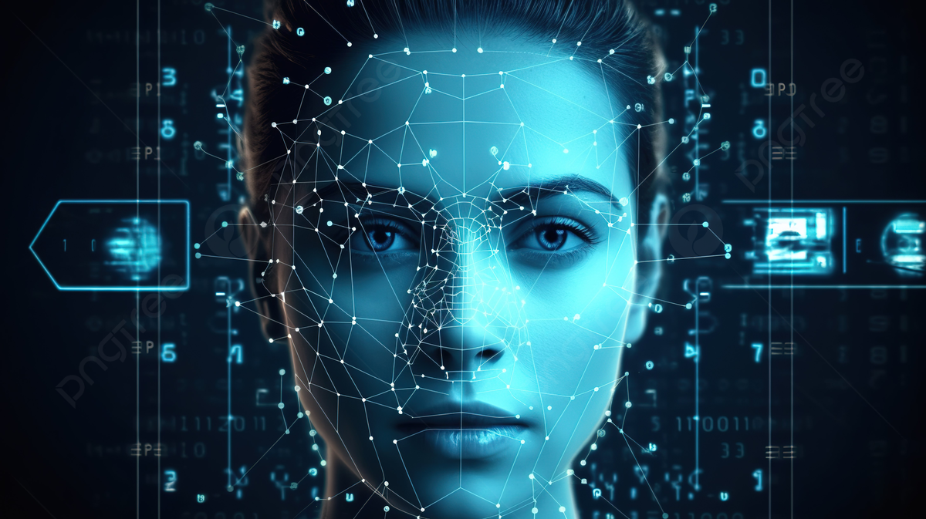
FACE EMOTION
DETECTION

Slide 2

MEET OUR TEAM
RIZWAN A
SYED ABDULLAH N
SACHITHANANTHAM P
JEEVITHA G
VAISHU RPS
SRAVANI S
ABINAIYA
KEERTHANA

Slide 3

CONTENT
Introduction
Methodology
Code Explanation
Result
Demonstration

Slide 4

Introduction
Detecting human emotions based on facial expressions
Why this topic?
Image Classification Problem
Emotion Identification has many applications
Integration with Social media and other platforms

Slide 5
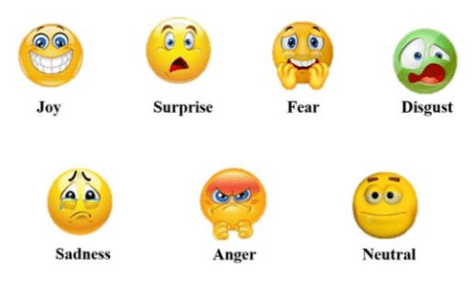
Example of 7 different Emotion

Slide 6
Methodology
Pre-processing
Input Image
haarcascade
Live i/p from cam
Face detection
Saved
weights
Comparison model
Trough trained neutral model
Output
Dominant Emotion
Emotion detection

Slide 7
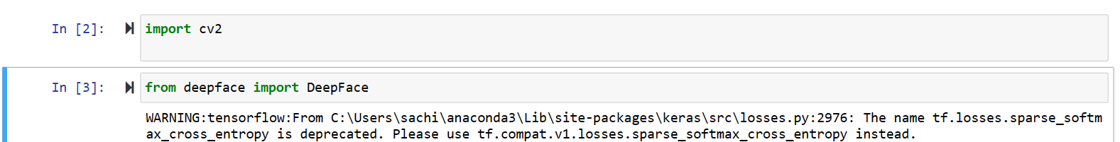
Code Explanation
OPENCV -This application lets you detect landmarks of detected faces in an image. You can detect landmarks of all the faces found in an image and use them further in various applications like face swapping, face averaging etc.

Slide 8
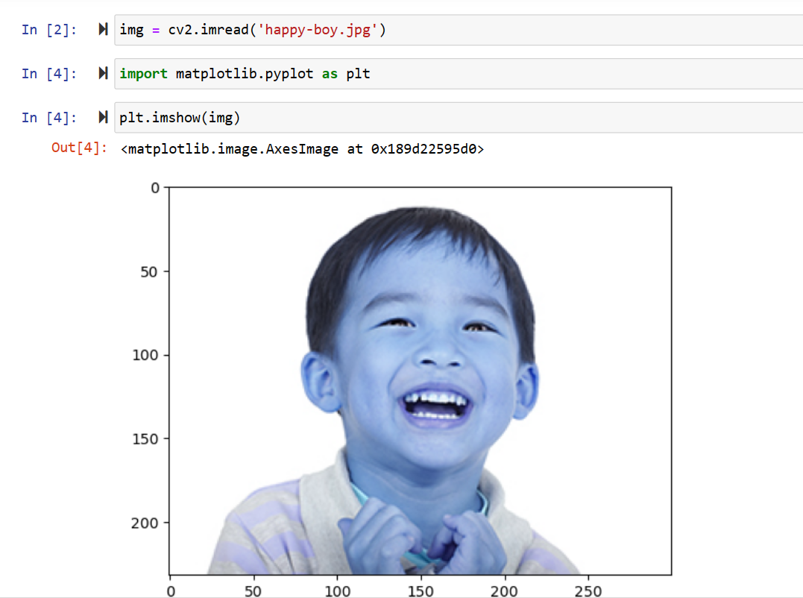
Code Explanation

Slide 9
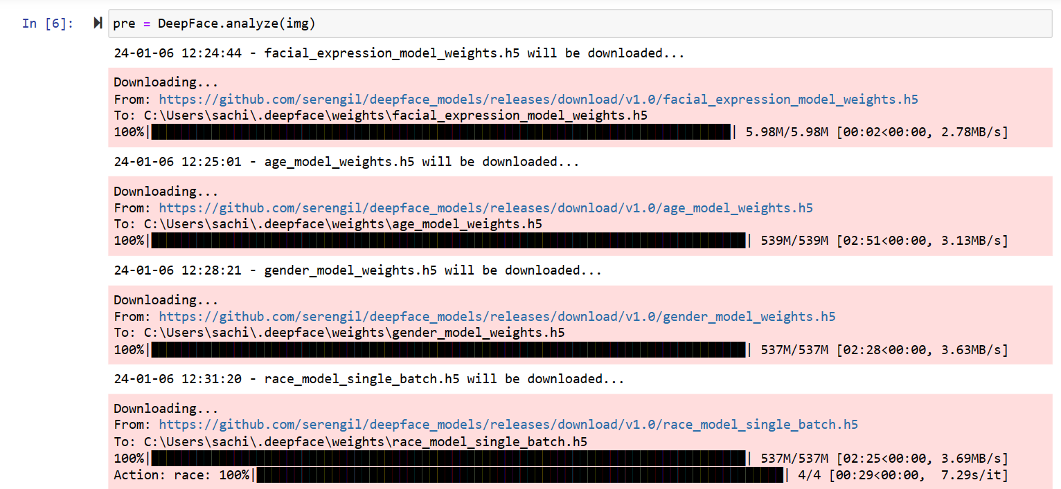
Code Explanation

Slide 10
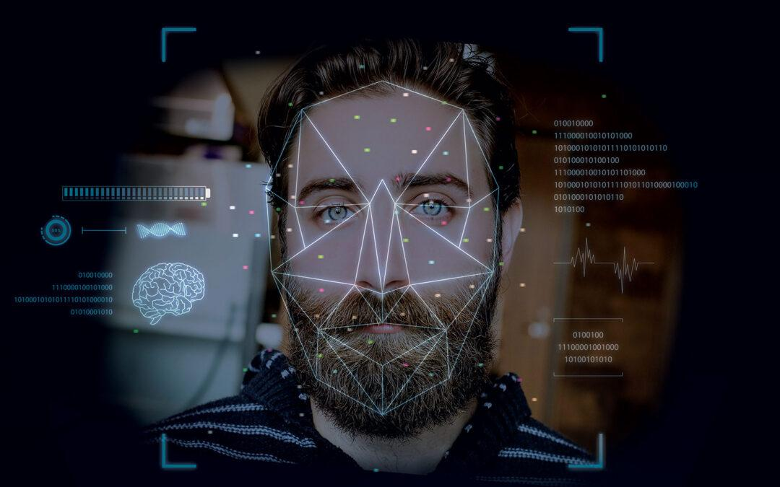
Code Explanation

Slide 11
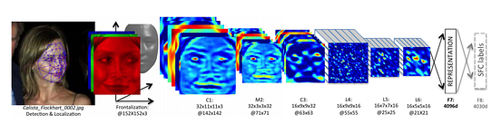
Code Explanation

Slide 12
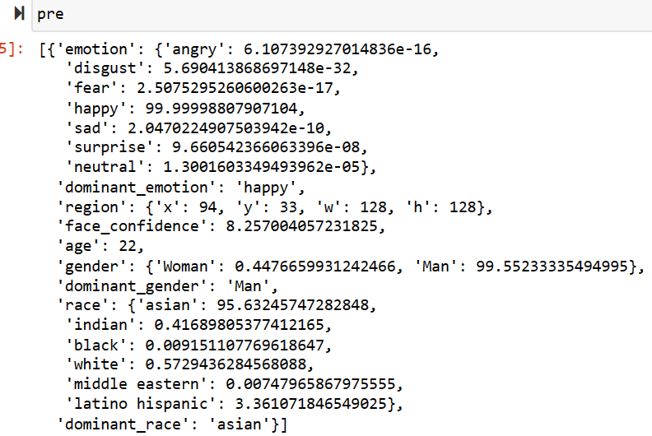
Code Explanation

Slide 13
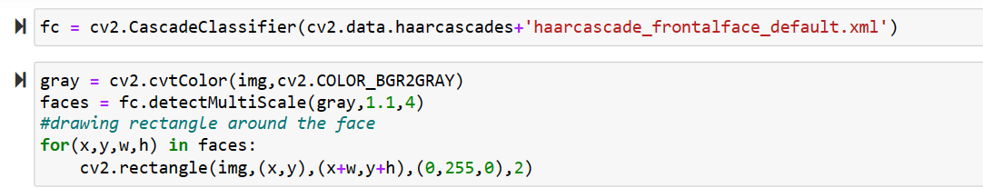
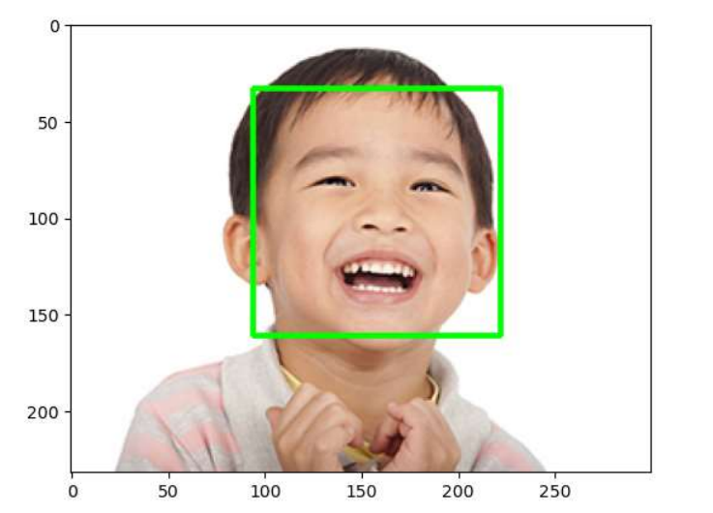
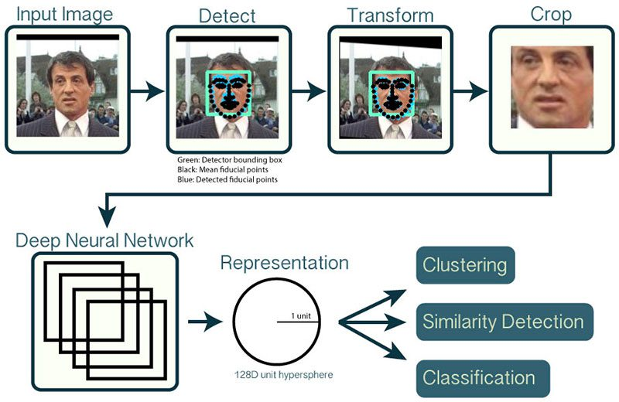
Code Explanation

Slide 14
Code Explanation
gray: This is likely the input image. The function detectMultiScale is probably being applied to a grayscale version of the image (commonly used in many computer vision algorithms).
1.1: This parameter represents the scale factor, as mentioned earlier. It indicates how much the image size is reduced at each image scale. A value of 1.1 means the image is being enlarged by 10% at each step for the purpose of multi-scale detection. Smaller values would lead to slower detection but potentially more accurate results.
4: This parameter denotes the minimum number of neighboring rectangles required to declare a detected region as the face. It helps filter out false positives by specifying how many neighbors a candidate rectangle should have to be considered a valid detection. Higher values might lead to more reliable detections but might miss some faces.

Slide 15
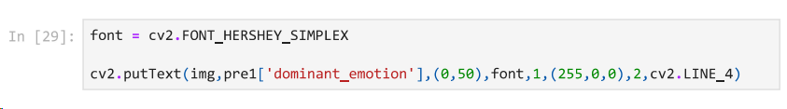
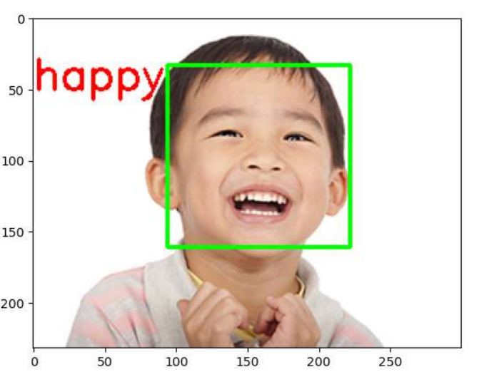
Code Explanation

Slide 16
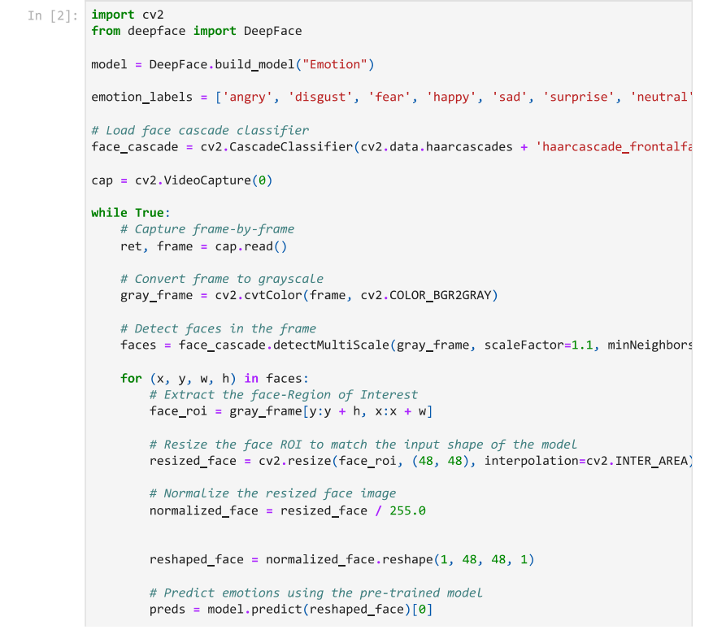
Code Explanation

Slide 17
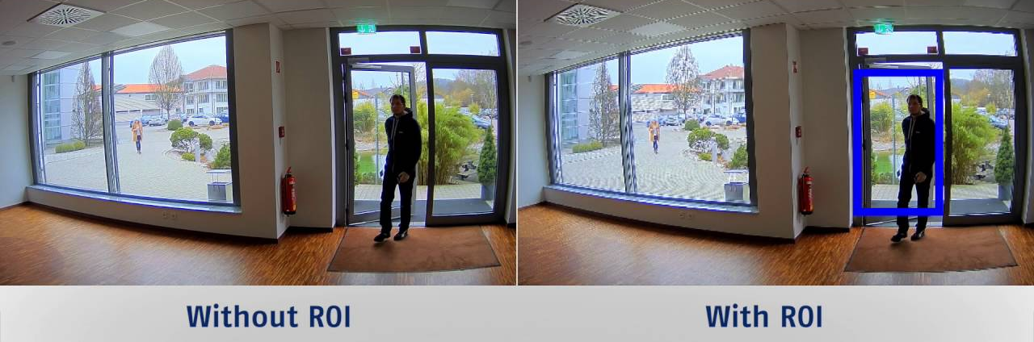
Code Explanation
Region Of Interest

Slide 18
Code Explanation
Shape(1,48,48,1)
1: It often denotes the number of samples or images in a dataset. In this case, it seems to refer to a single image or a batch containing one image.
48, 48: Indicates the dimensions of the image after reshaping, specifically a 48x48 grid, which likely represents the height and width of the image in pixels.
1: Typically denotes the number of channels in an image. For grayscale images, like in many facial recognition tasks, there's often one channel representing the intensity or grayscale values of pixels. For RGB images, there would be three channels (red, green, blue).

Slide 19
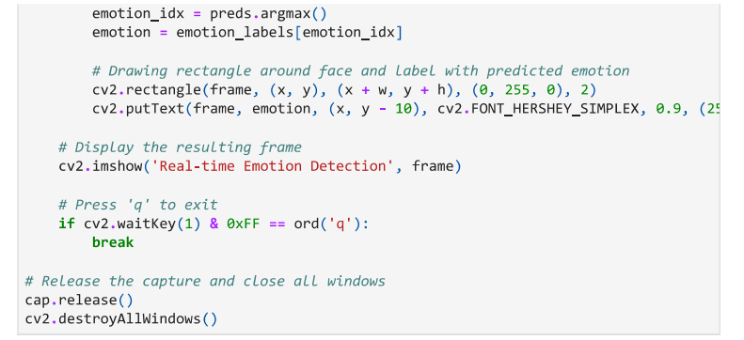
Code Explanation

Slide 20
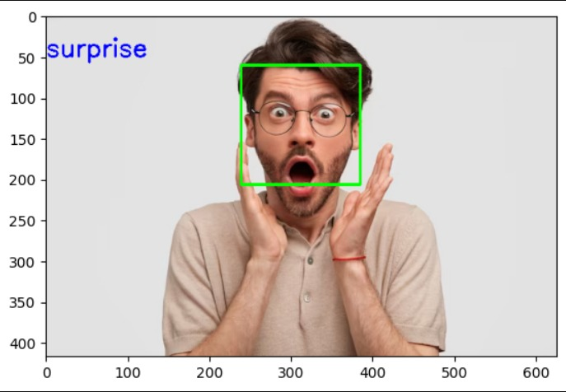
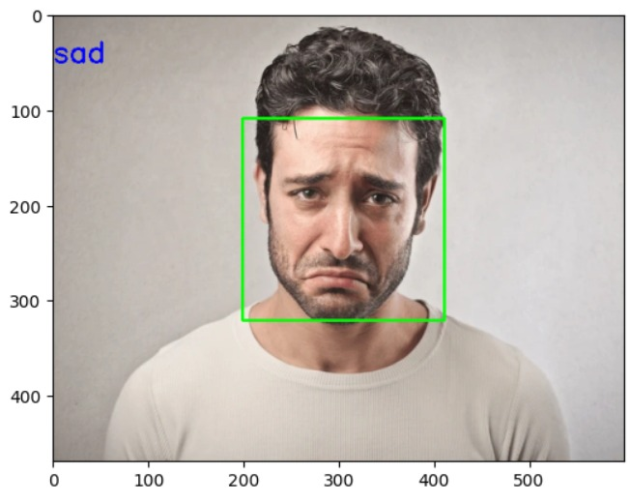
Result

Slide 21
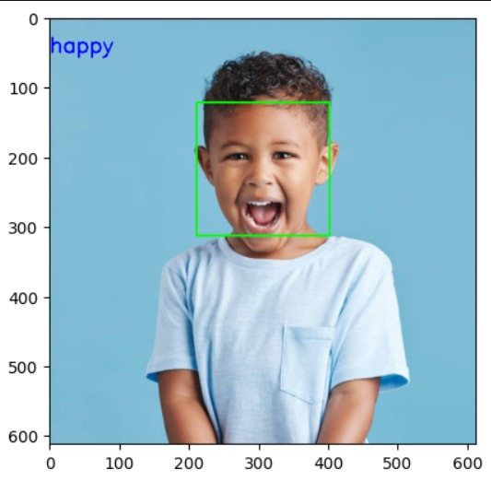
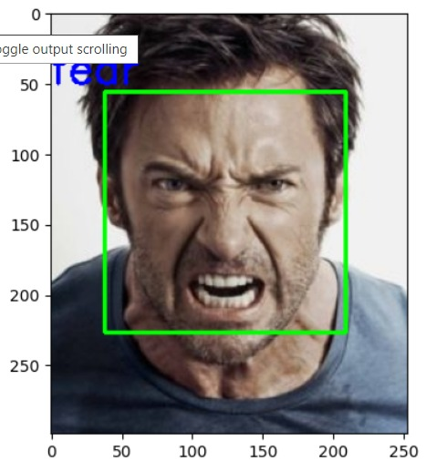
Result

Slide 22
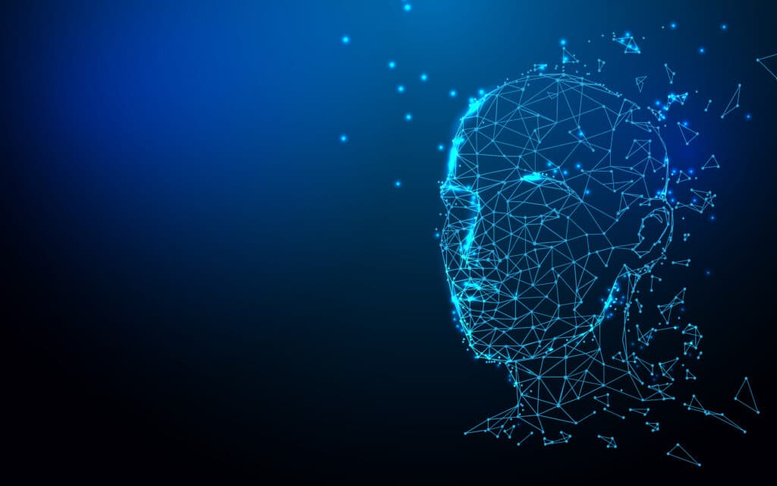
THANK YOU

